Slide 1
IFSA

Slide 2
AINE OSBORNE Email: AINE.OSBORNE@carat.com Twitter: @aineosborne

Slide 3
Notes:
7 billion people in the world.
50% of those are under the age of 30 which means they have never known life without the internet

Slide 4
Notes:
This is how the internet started...

Slide 5
Notes:
Quickly it expanded to search, blogs, feeds etc

Slide 6
Notes:
But when social arrived it really exploded

Slide 7
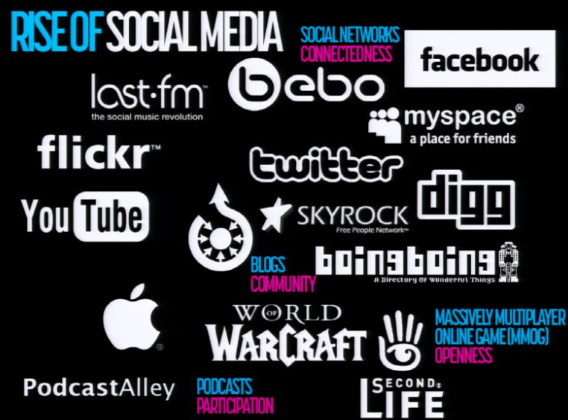
Notes:
Key themes: Participation, openness, sharing, community, conversation and connections

Slide 8
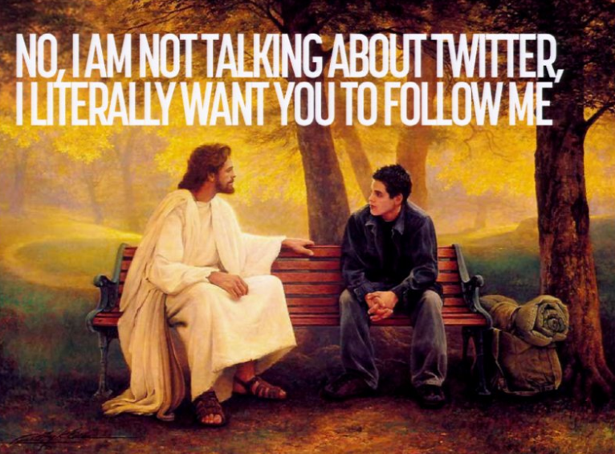
Notes:
We have moved away from the information age to the social age. This image reflects life at the moment.

Slide 9
Notes:
This image is doing the rounds at the moment. I think it reflects the underwhelming experience social can have if it is not used correctly.

Slide 10
Notes:
Digital behaviour is changing. At one point it was only used for entertainment, then information but now it needs to play a useful role.
If you can be used in a persons day to day habits then you are on to a winner. So this means talking to people when they check their mails, social etc at first thing in the morning.

Slide 11
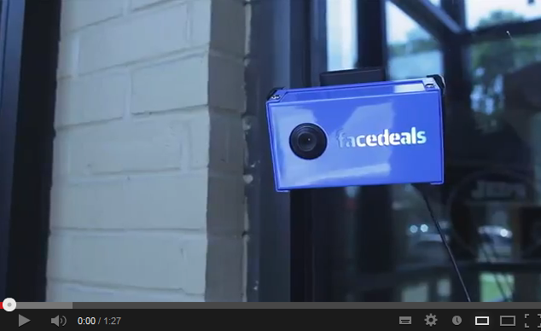
Notes:
http://www.youtube.com/watch?v=sLOxUVvcjwE

Slide 12
Notes:
The level of messages people get in Social is massive so you need to do something that will grab their attention and hold it. People are passively consuming in their Facebook and Twitter newsfeeds so you need to standout.

Slide 13
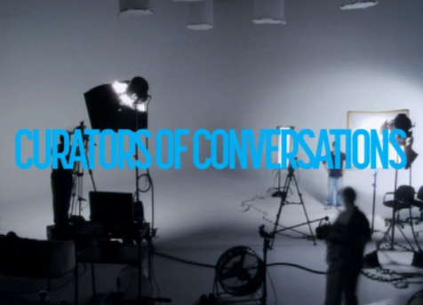
Notes:
All brands should be curators of conversations. This allows for two way conversation. Your customers will be the first ones to tell you what you are doing right and wrong. You should listen, take it on board and build.

Slide 14
Notes:
Reactive, relevant and remarkable.
If you want to be in the space of being useful to someones day to day life you need to be reactive. The majority of people are passive about your brand stories but that small amount that are reactive expect you to be reactive back.
You need to be relevant or you will be ignored.
Most importantly you need to be remarkable. This will help you stand out. It is difficult but it will be the most important thing that you do.

Slide 15
Getting started
Listen
Set objectives
Plan Resource and time
Measure and learn
Notes:
What else is going on in your market and what do customers want?
Why are you doing this? Don’t just throw up a Facebook/Twitter page because everyone else is. What do you want this to achieve for you?
Social Media is always on so you need to know who is going to react to your customers.
Don’t be afraid to make mistakes and make sure your staff know that you are open to that.

Slide 16
Social Listening tools
Notes:
SocialMention.com
Klout
Peer Index

Slide 17
Blogging tools
Blogging tools that allow you to create your own blog
Wordpress.com
Blogger.com

Slide 18
Dominate listings
Twitter
Facebook
Google +

Slide 19
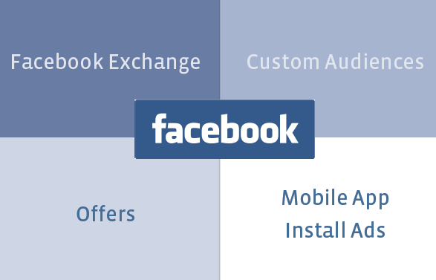
Driving results

Slide 20
Exchange

Slide 21
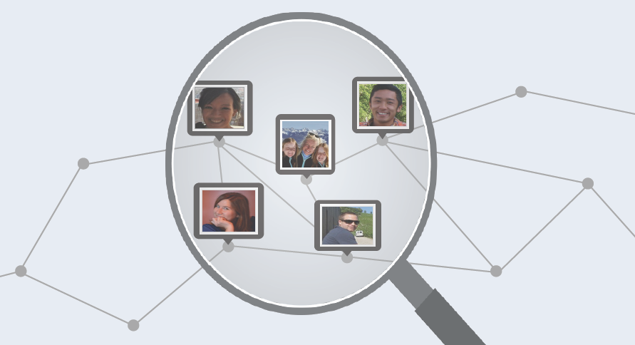
Custom audiences

Slide 22
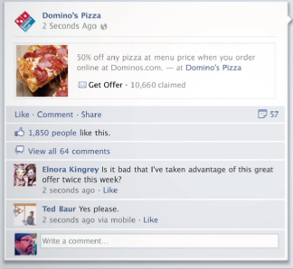
Offers
94,000 offers claimed
32,000 redeemed

Slide 23
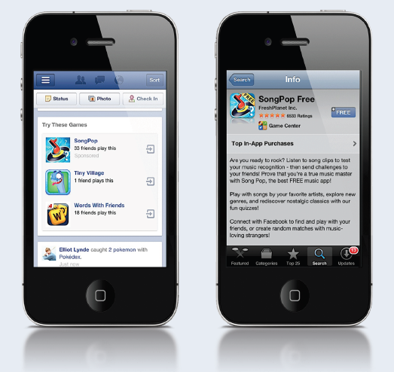
App installs

Slide 24
Tips for content strategy
Objectives
Personality
Content
Engagement
Measurement

Slide 25
CREATE ASSETS FROM THE INSPIRATION AROUND YOU

Slide 26
Notes:
Burberry tweeted photos of their models moments before they walked on to the catwalk. This meant the people who follow Burberry got to see the collection before all the top fashion magazines. This form of rewarding customers for their interest is going to get more and more popular. Also it doesn’t cost you anything.
Treat your customers like VIPS

Slide 27
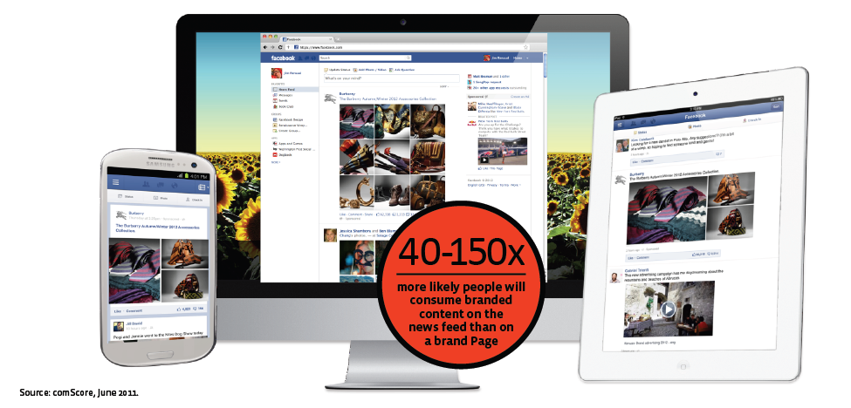
stay connected with fans

Slide 28
Friends make ads relevant
50% UPLIFT
In ad recall

